Slide 1

Using R for Geodemographic Analysis
Thursday 10th July, 10:45am – 4pm
Dr Nick Bearman
@nickbearmanuk
Department of Geography and Planning
Geographic Data Science Lab

Slide 2


Welcome
Using R for Geodemographic Analysis
Who has used R before?
Who has used another GIS before?
(ArcGIS, MapInfo, QGIS, ….)
Who has used geodemographic data before?

Slide 3
Outline of the day
11am – 11:30am – Talk
11:30am – 12:45pm – Practical
12:45pm – 1:30pm – Lunch
1:30pm – 2:30pm – Practical
2:30pm – 3pm – Talk
3pm – 4pm – Optional Mapping Clinic

Slide 4
Outline
What will you get from the course?
What is R & what can you do with it?
R as a GIS
Geodemographics
Notes on R
Introductions & logon

Slide 5
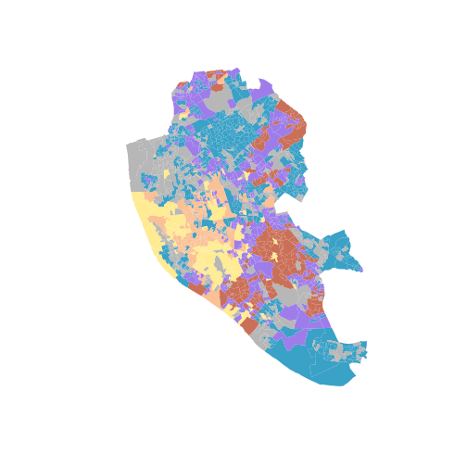
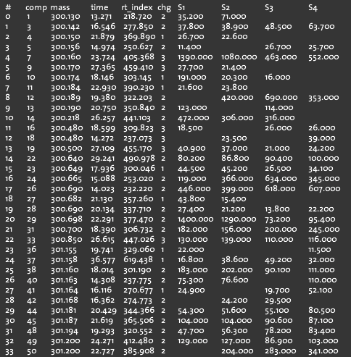
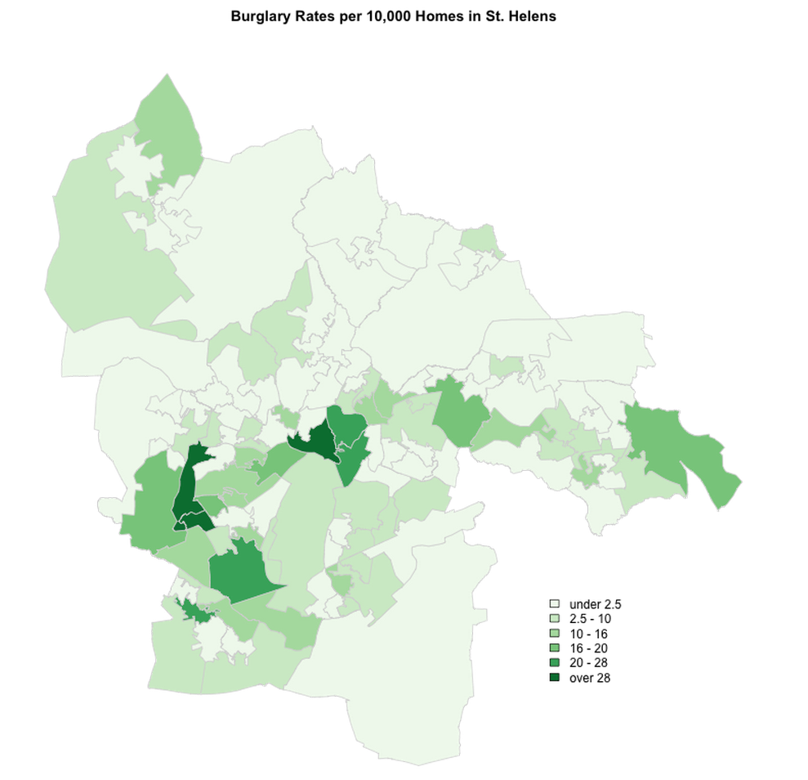
What is GIS?
Turning (spatial) data into information
Using this information to answer questions
How have housing conditions changed in the past ten years?
http://www.flickr.com/photos/dsleeter_2000/3097476532

Slide 6

What is R?
“a freely available language and environment for statistical computing and graphics”
freely available = ‘free as in beer’ and ‘free as in speech’
graphics = GIS
user contributed – GIS
packages / libraries

Slide 7
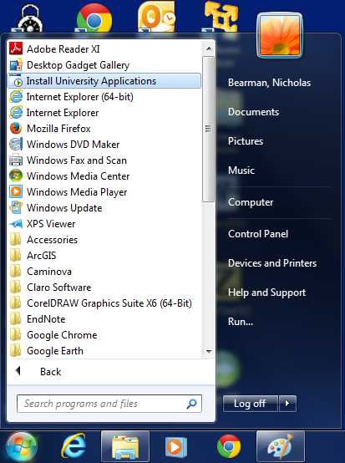

Installing R 3.0.1…
R Installed Already?

Slide 8
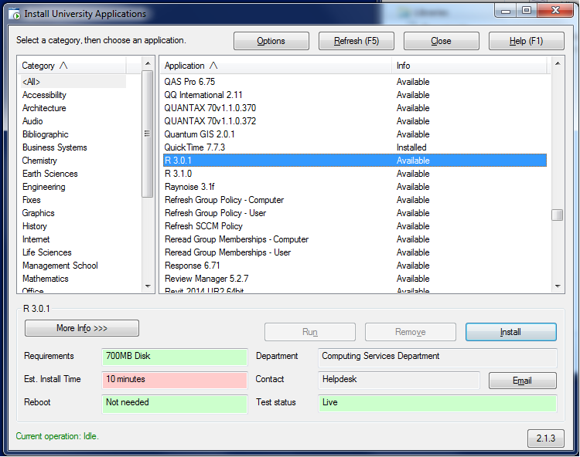
Installing R 3.0.1…

Slide 9
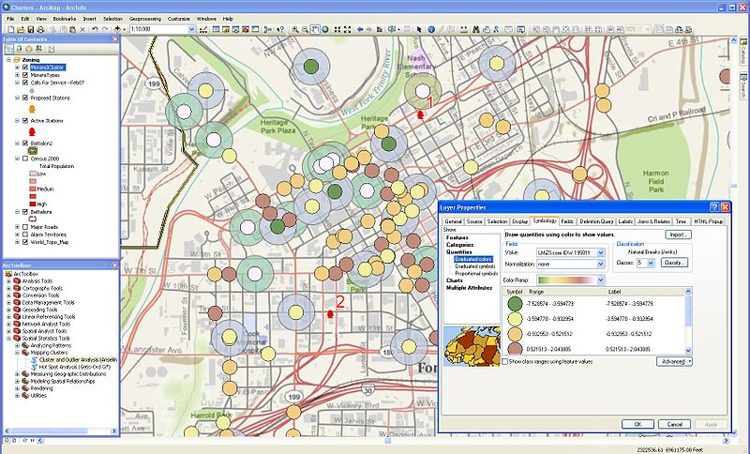
GIS – Geographic Information Systems
http://en.wikipedia.org/wiki/File:Arcgisclusters.jpg

Slide 10
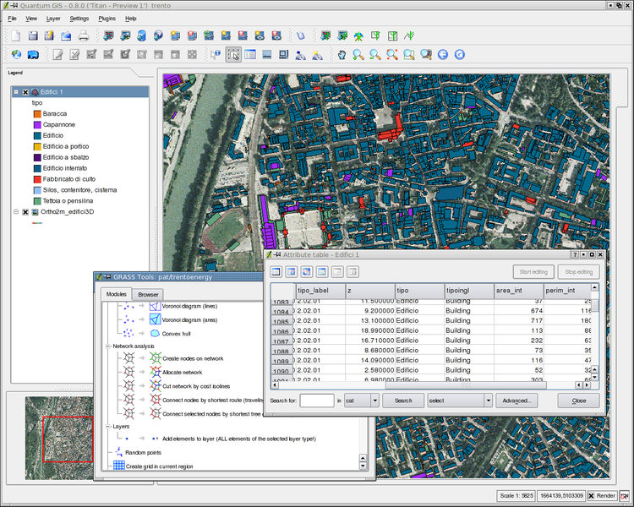
GIS – Geographic Information Systems
http://en.wikipedia.org/wiki/File:Qgis08_grass6_toolbox.png

Slide 11
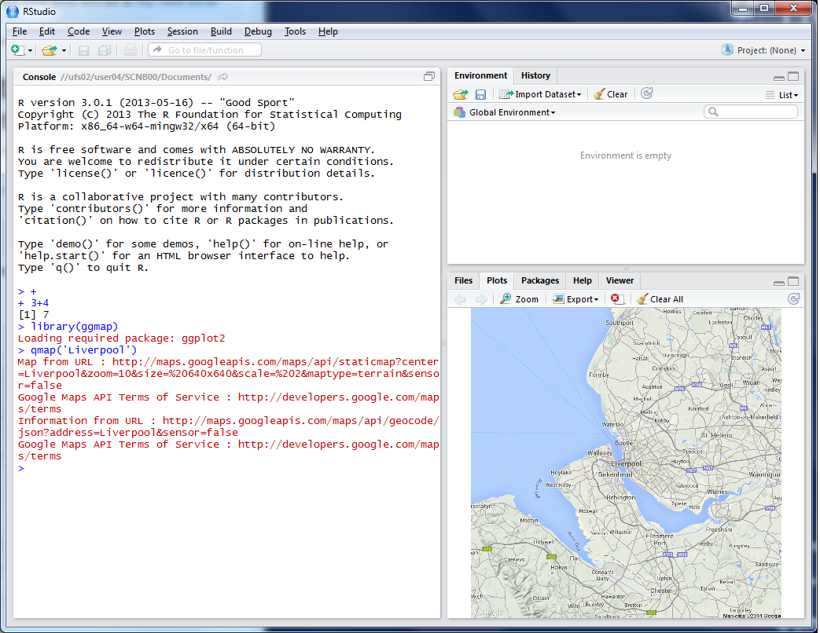
R as a GIS
Command line driven, rather than GUI
Disadvantages
Steeper learning curve
Remembering commands

Slide 12
R as a GIS
Advantages
Easy to record what you did and repeat specific pieces of work
Lots of reproducible examples on the web
Easily scriptable. 134,567 maps? easy!
2011 Census Open Atlas
http://www.alex-singleton.com/r/2014/02/05/2011-census-open-atlas-project-version-two/

Slide 13
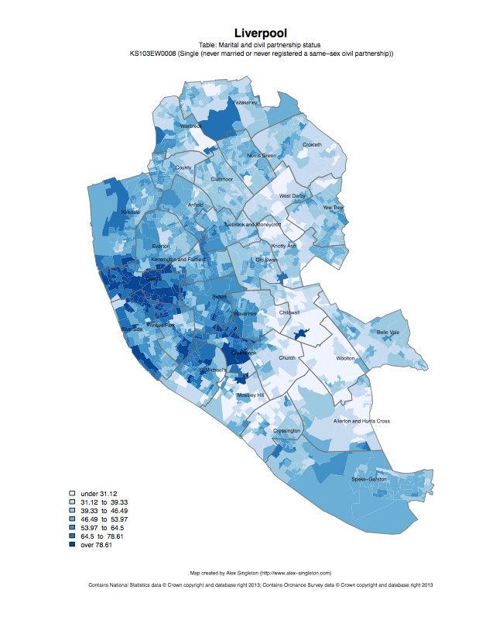
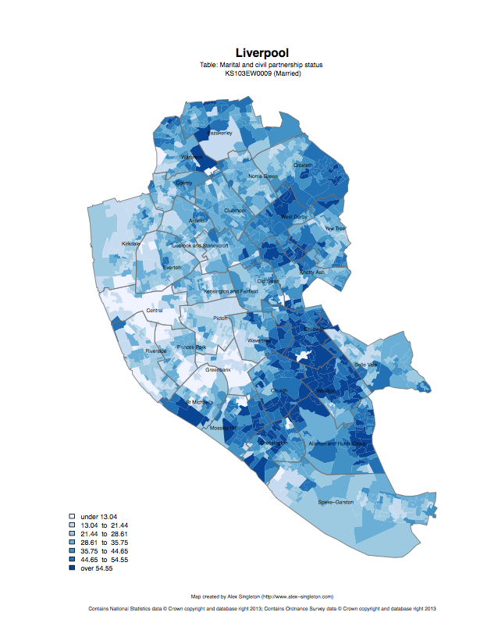
Single
Married

Slide 14
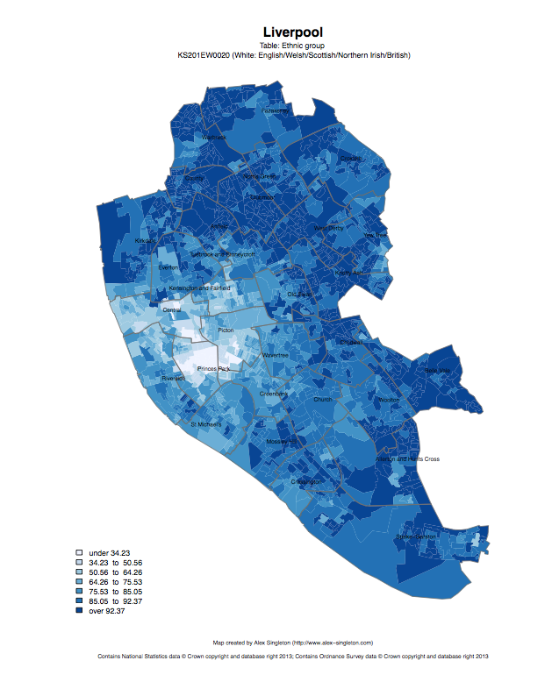
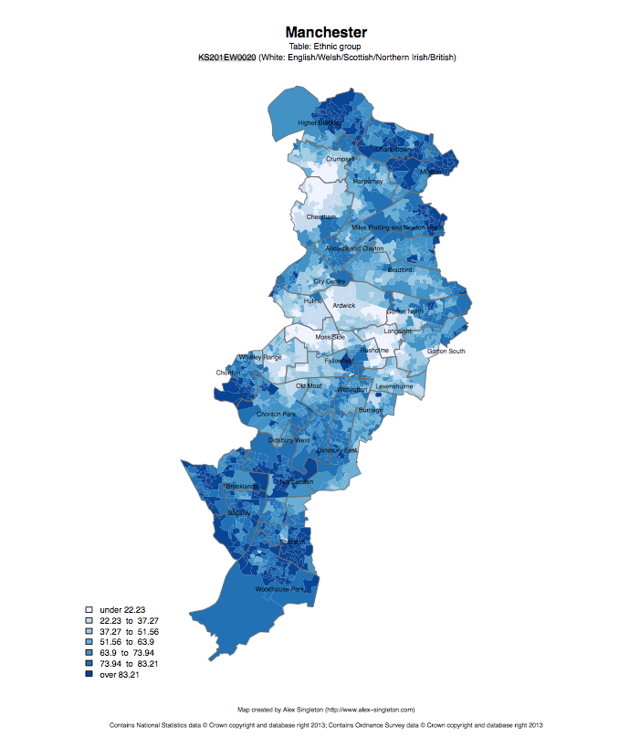
Ethnic group: white

Slide 15
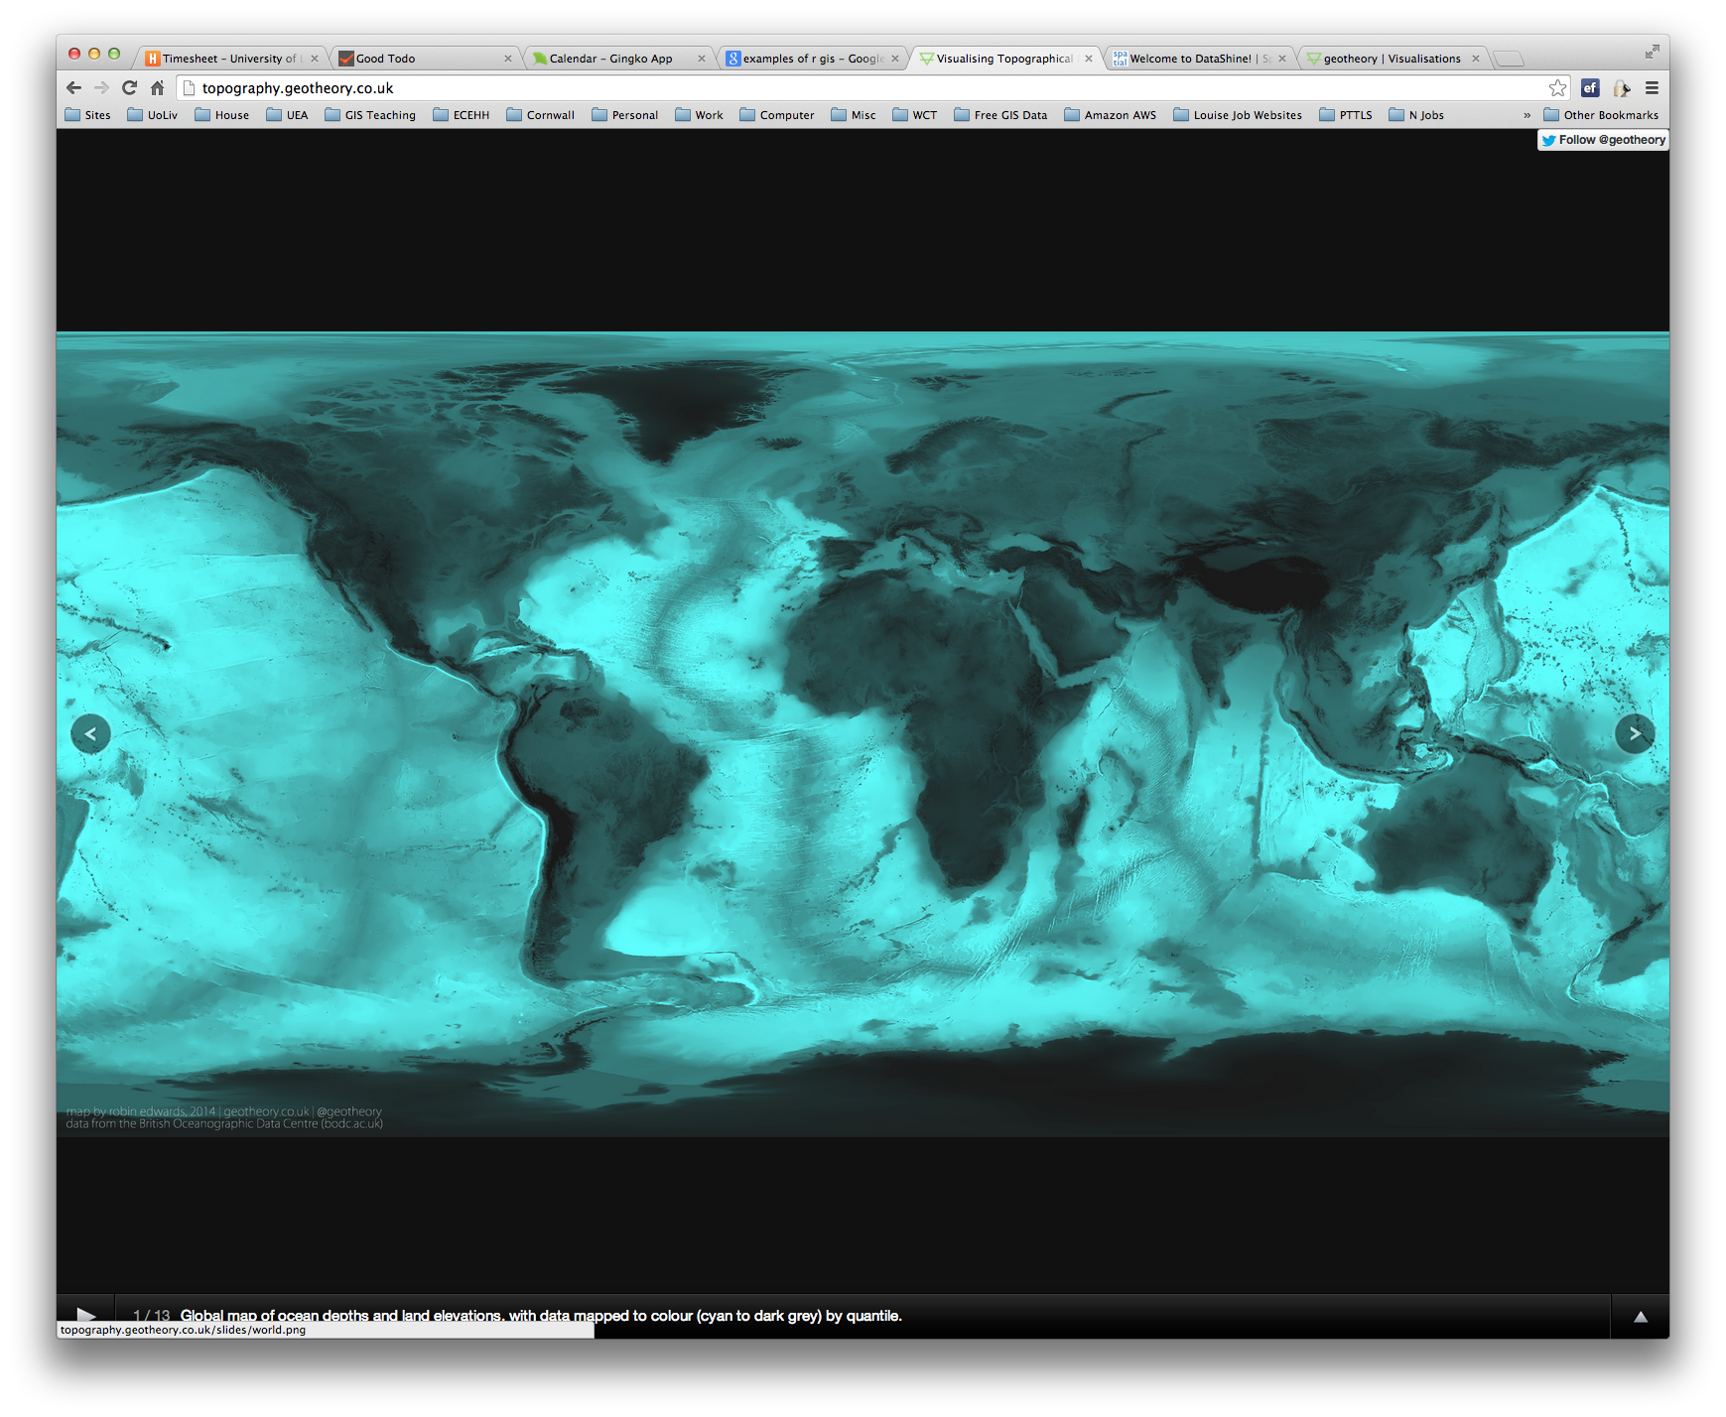
R as a GIS
Topography
http://topography.geotheory.co.uk/

Slide 16

Twitter Languages in London
http://spatial.ly/2012/10/londons-twitter-languages/

Slide 17
R as a GIS
R is just another tool in the toolbox
I use it alongside ArcGIS, QGIS, etc.

Slide 18
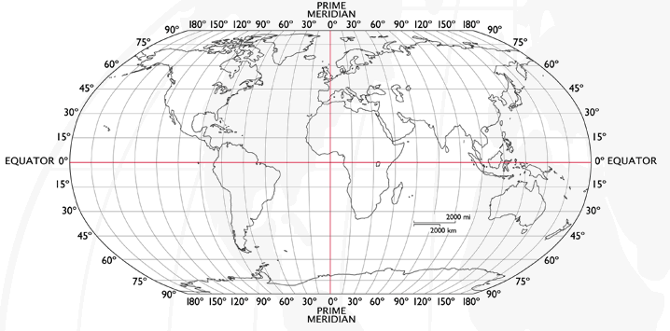
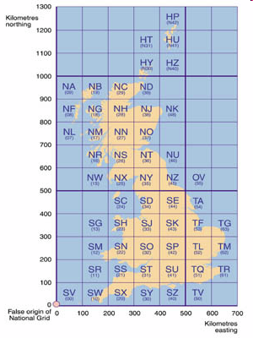
Coordinate Systems
Latitude and Longitude (WGS 1984) EPSG = 4326
52°N 37’ 30.32’’ (52.6250) 1°E 14’ 2.05’’ (1.2339)
British National Grid (Eastings & Northings)
Easting: 619301 Northing: 307416 EPSG = 27700
Why is it important?
Some data in WGS84 (lat/long)
Some use BNG (Eastings/Northings)
Need to convert between the two
Notes:
-Coordinate Systems are derived from projections and are used to give coordinates (numbers) to locations on the Earth’s surface
-Best if your data is all in the same coordinate system (otherwise the coordinates might be slightly different for the same location), but ArcMap can convert between them
-Most common:
-Lat/Long (also WGS 1984) used by most GPS
-BNG (British National Grid) very common in UK data – Ordnance Survey format.
-Most important – are all your data in the same coordinate system?
-ArcMap can convert, but often if your data appears in the wrong place, it is because there is something wrong with the coordinate system.
http://www.worldatlas.com/webimage/testmaps/latslongs.htm
http://www.ordnancesurvey.co.uk/oswebsite/gps/information/coordinatesystemsinfo/guidetonationalgrid/page13.html
http://www.ordnancesurvey.co.uk/oswebsite/gps/information/coordinatesystemsinfo/guidetonationalgrid/page8.html

Slide 19
Geodemographics
Brief overview
What it is and why it’s used
MSc Applied Geographical Information Science

Slide 20
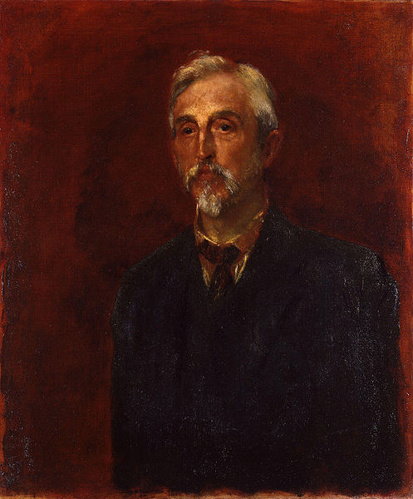
30 March 1840 – 23 November 1916
Shipping business owner & Philanthropist
Survey:
“Life and Labour of the People in London”
First Edition
Life and Labour of the People, Vol. I (1889)
Labour and Life of the People, Vol II (1891)
Second Edition
Life and Labour of the People in London; 9 volumes 1892-97
Third Edition
Life and Labour of the People in London; 17 volumes (1902-03)
Quantitative and Qualitative
Charles Booth
http://en.wikipedia.org/wiki/File:Charles_Booth_by_George_Frederic_Watts.jpg

Slide 21
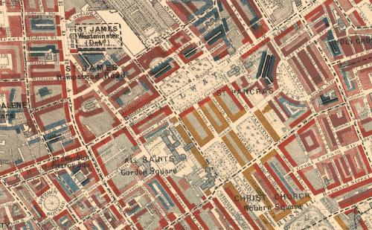
Description
BLACK: Lowest class. Vicious, semi-criminal.
DARK BLUE: Very poor, casual. Chronic want.
LIGHT BLUE: Poor. 18s. to 21s. a week for a moderate family
PURPLE: Mixed. Some comfortable others poor
PINK: Fairly comfortable. Good ordinary earnings.
RED: Middle class. Well-to-do.
YELLOW: Upper-middle and Upper classes. Wealthy.

Slide 22



Origins of Geodemographics
Technique developed in 1970’s attributed to Richard Webber
Identify similar neighborhoods
Target urban deprivation Funding
Public Sector – Government
Enumeration District Level

Slide 23
Geodemographic Classification
Experian: Mosaic
Acorn: CACI
People2Places
OAC 2001 and 2011

Slide 24

OAC
41 Variables
100% 2001 Census
Open Methodology
Peer Reviewed
ONS and UCL
7 SuperGroups
21 Groups
52 SubGroups

Slide 25
7 Supergroups, 21 Groups and 52 Subgroups:
1 – Blue Collar Communities
2 – City Living
3 – Countryside
4 – Prospering Suburbs
5 – Constrained by Circumstances
6 – Typical Traits
6a – Settled Households
6b2 - Suburban Families
7 – Multicultural

Slide 26
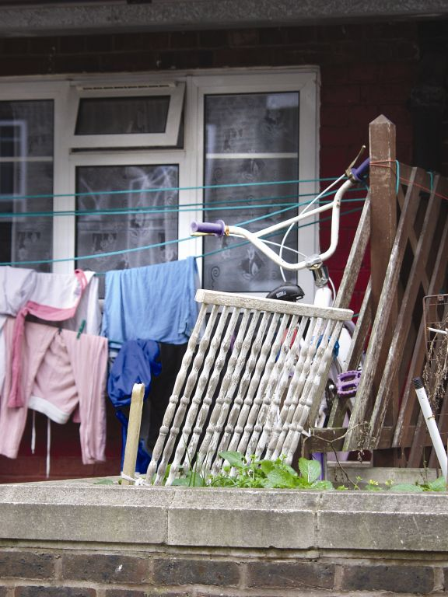
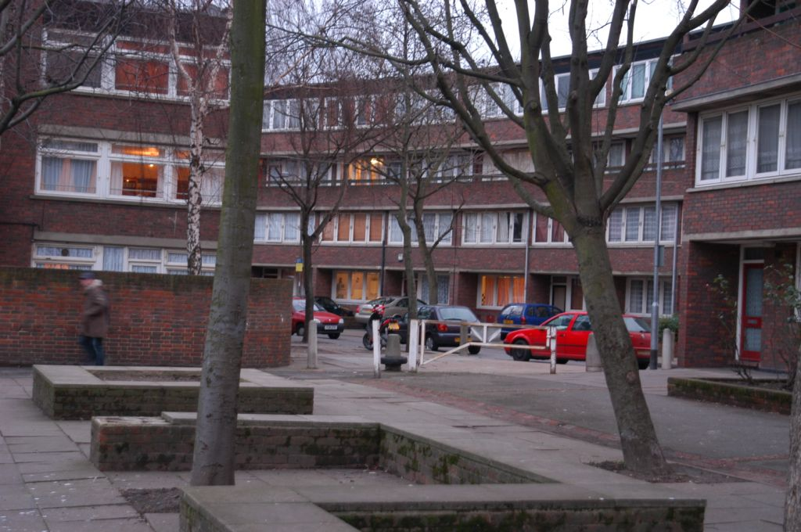
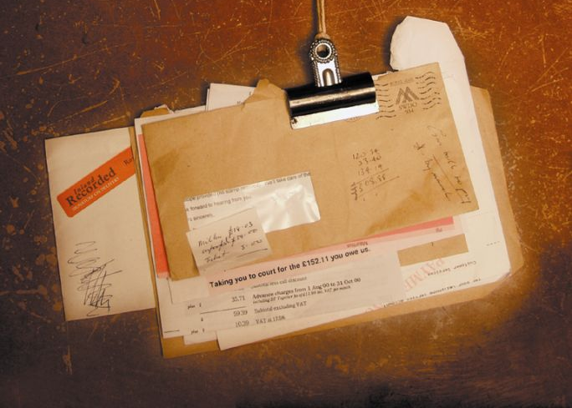

2 – City Living
“Pen Portraits:”
Densely populated urban areas with a young multi-ethnic population, primarily in and around London.
High debt
Low home ownership
Poor health

Slide 27
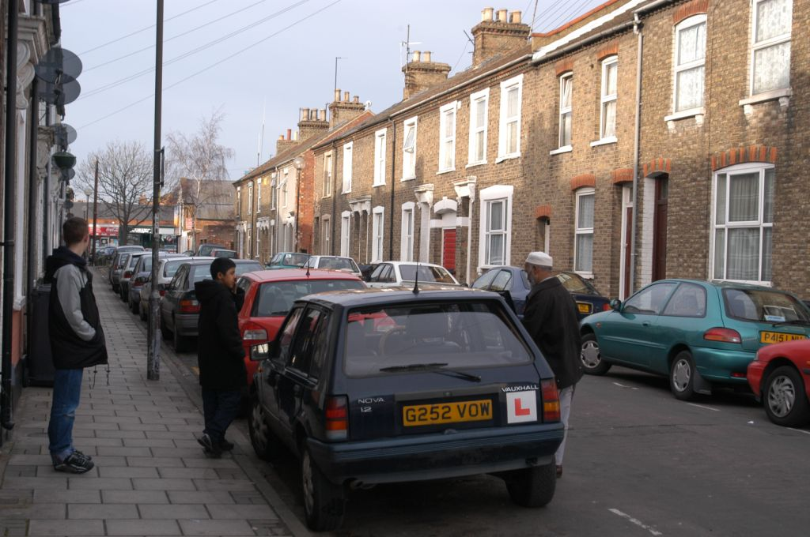
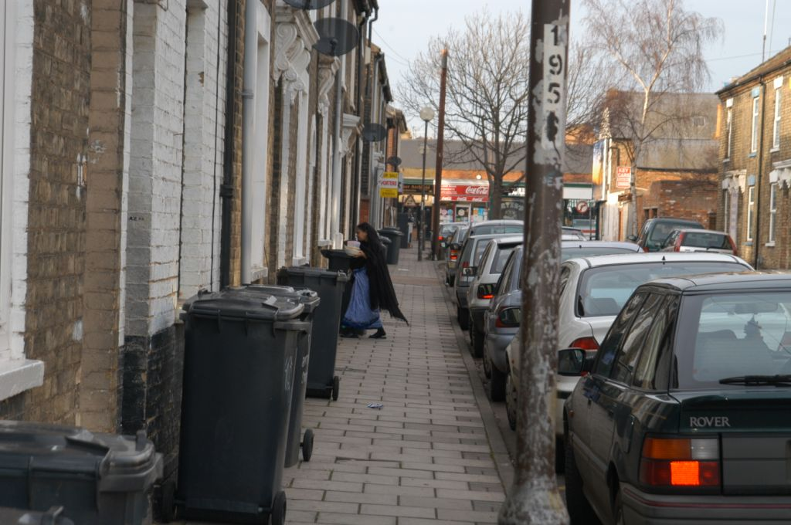
7 - Multicultural
These are poor urban areas where poorly paid young people and a relatively high ethnic mix are key characteristics. These young families live in the terraced streets of many major cities, including Birmingham, Bradford and London.

Slide 28
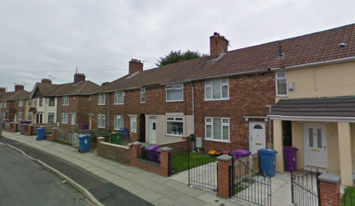
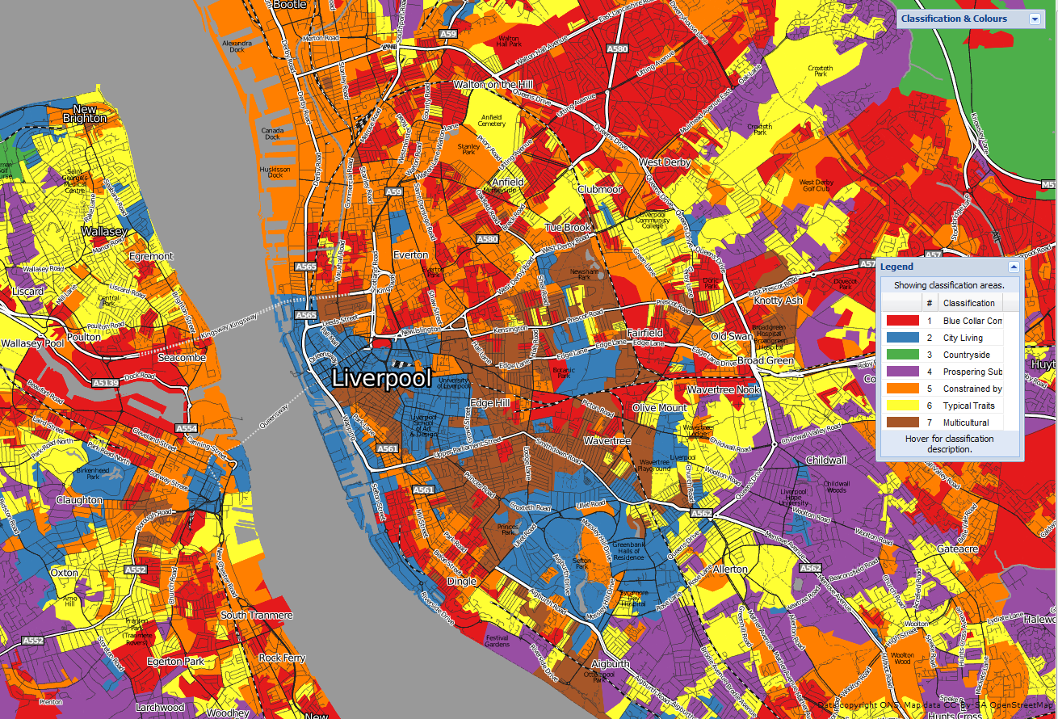
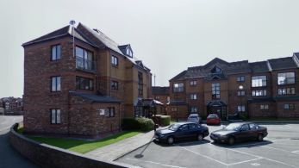
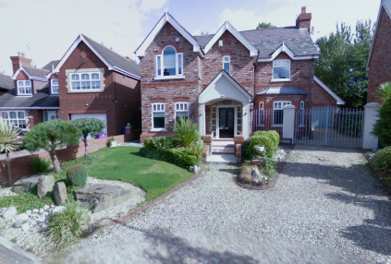
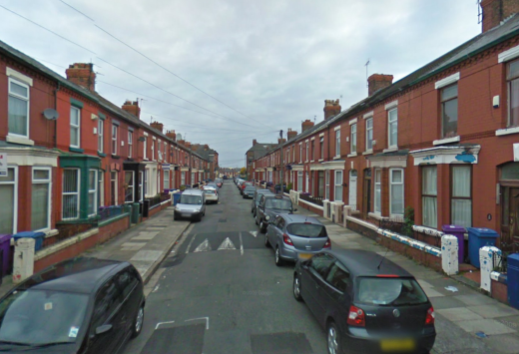
Blue Collar
City Living
Prospering Suburbs
Multicultural
OAC

Slide 29
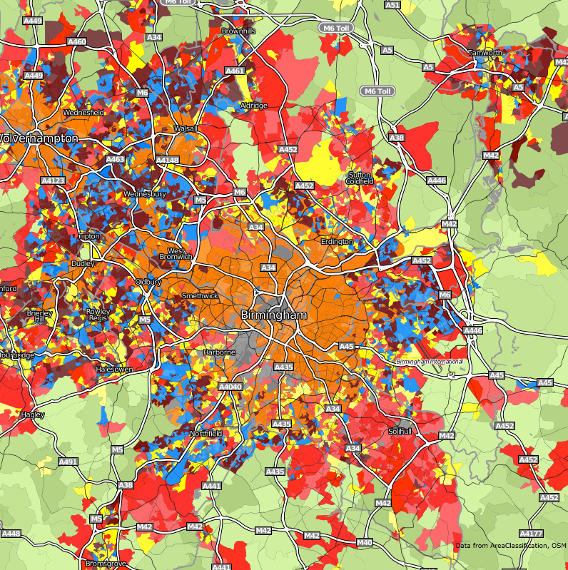
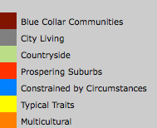

Slide 30
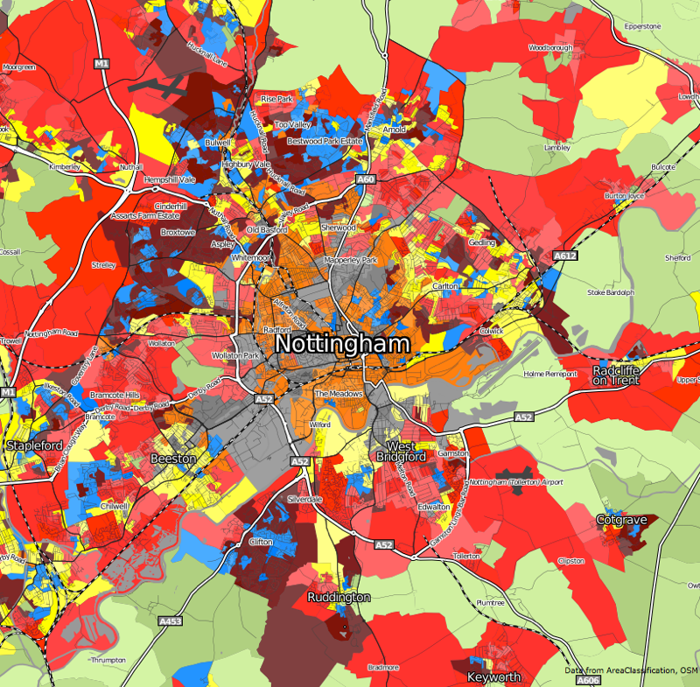

Slide 31
Cluster Analysis
Variable 2
Cluster 1
Cluster 2
Variable 1
Cluster 3

Slide 32
Output Area Classifications (2011)
Collaboration between ONS and UCL
Preliminary
Three-tiered hierarchical classification
8 Supergroups, 24 Groups and 67 Subgroups
http://www.opendataprofiler.com/2011OAC.aspx

Slide 33
Index Scores
Compares groups characteristics to the wider population
100 = group same as national average
200 = twice national average
50 = half national average

Slide 34
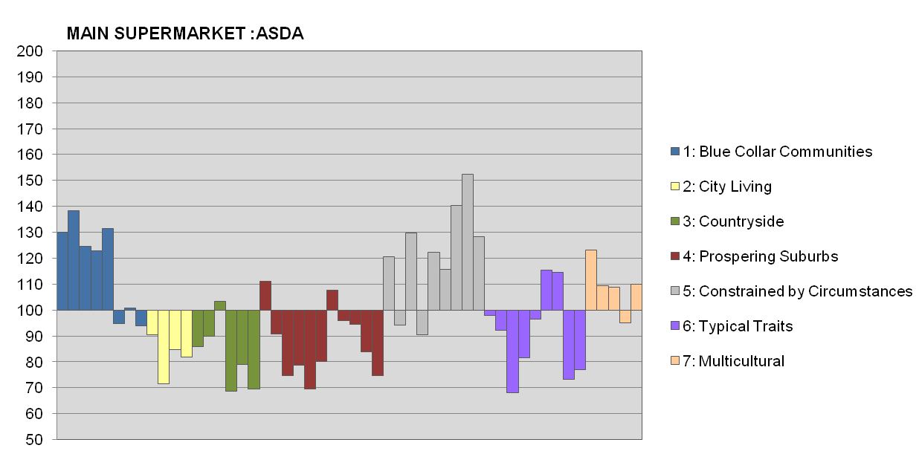
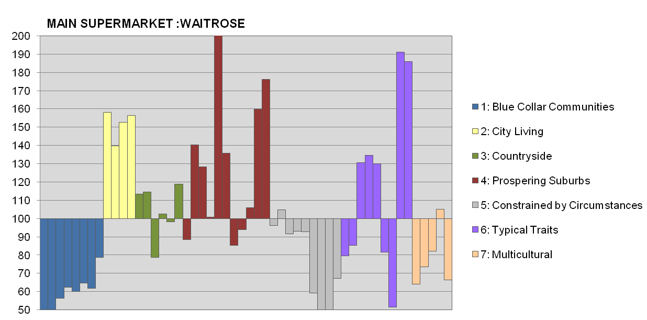
Asda
Waitrose

Slide 35
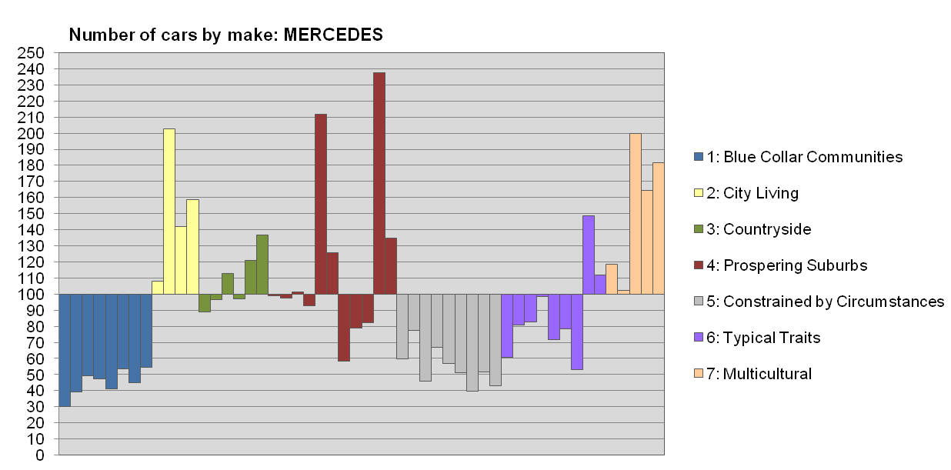
Who owns a Mercedes?

Slide 36
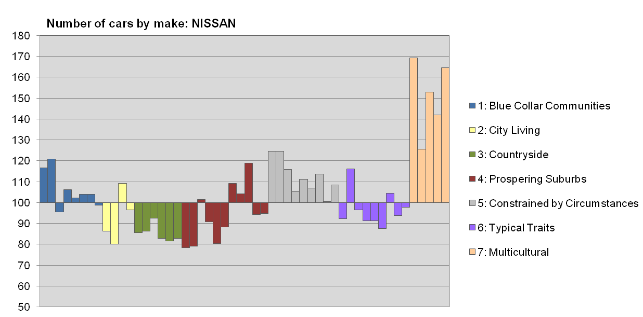
Who owns a Nissan?

Slide 37
Uses
Targeting mail shots
Shop site selection
Credit scoring
Car insurance

Slide 38
R Notes - Working Directory
R uses a ‘working directory’ to store your files in
You might have a different one for each project / piece of work
e.g. M:\Documents\GIS
setwd(“M:/Documents/GIS”)

Slide 39
Variables
R uses variables to store information – listed in your ‘workspace’ (top-right)
When you close R Studio, save workspace
liverpool <- readShapeSpatial('liverpool_OA/ liverpool', proj4string = CRS("+init=epsg:27700"))

Slide 40
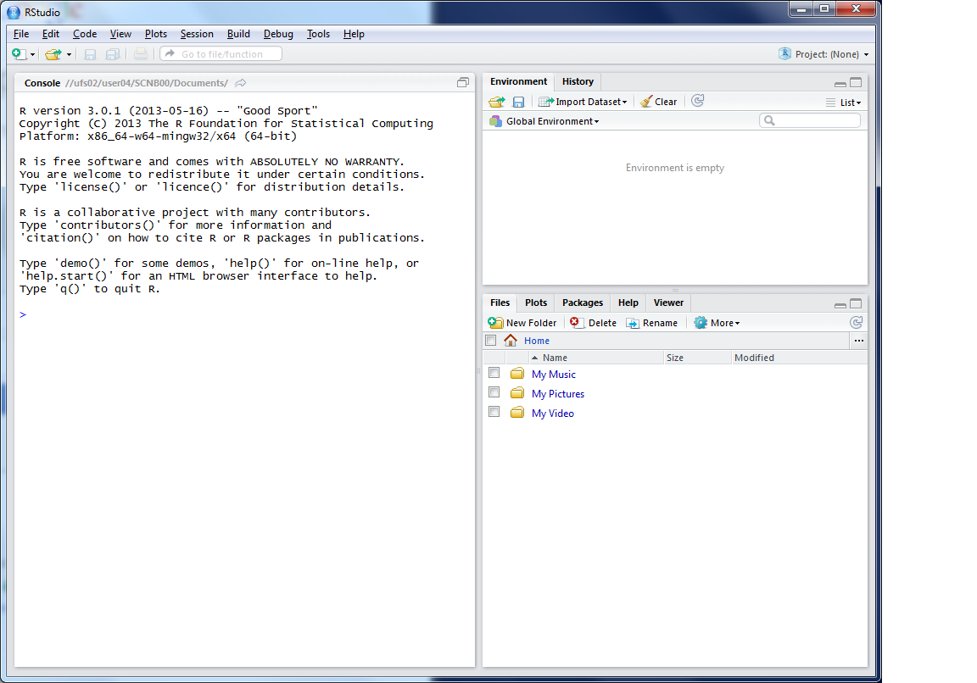
This lists the variables you have
This is the console where you can type in commands
Here will show either your files (the files tab) or your plots (the plots tab)

Slide 41
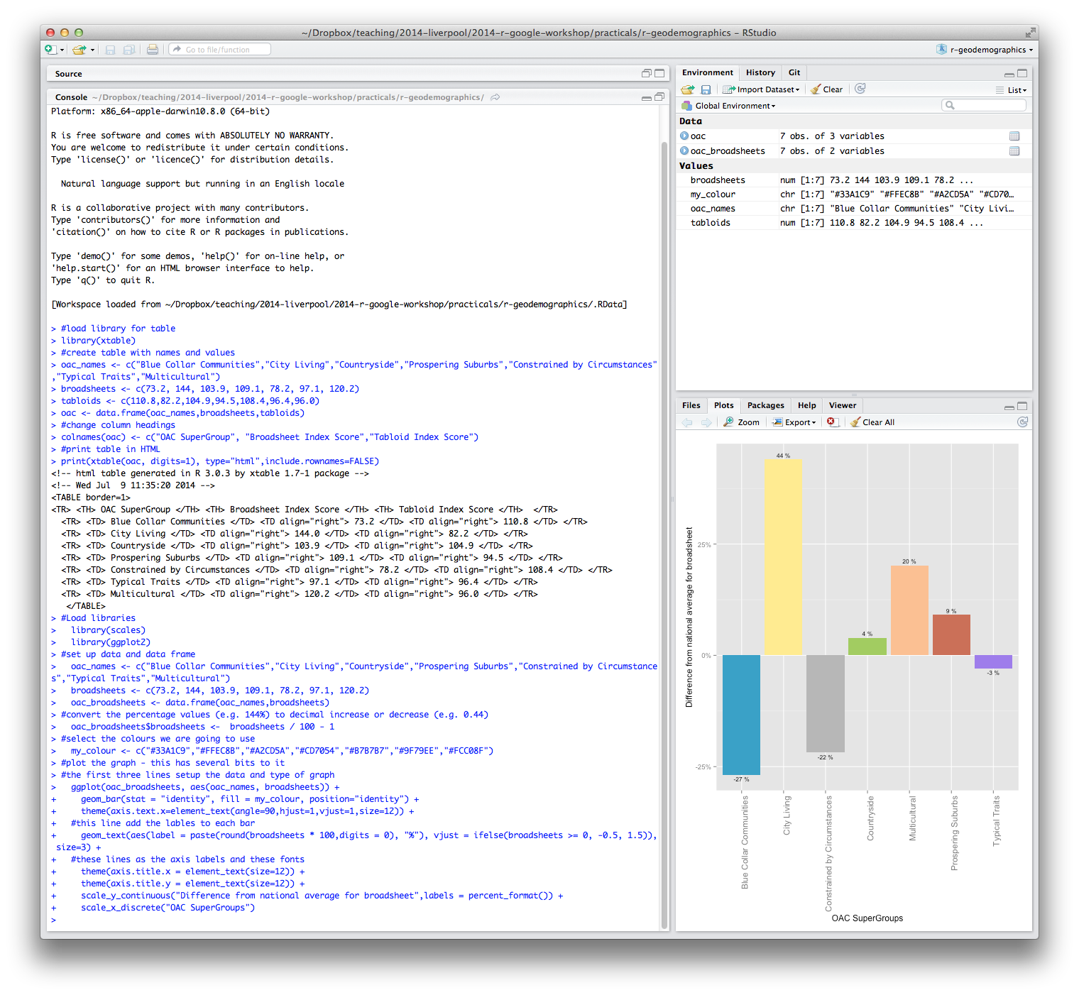

Slide 42
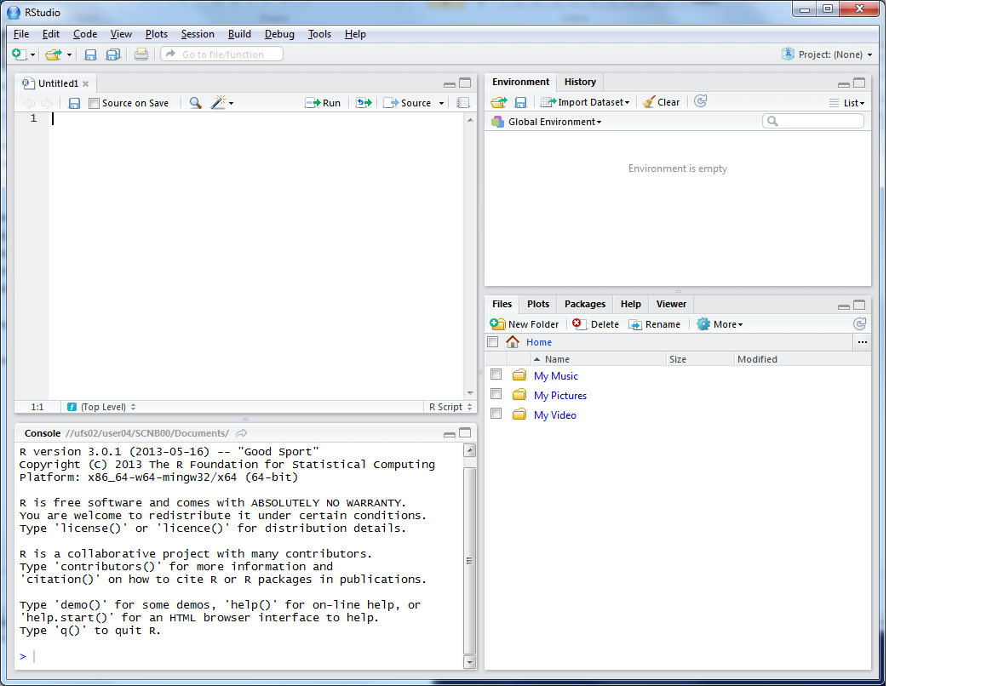
This is where you can write scripts
This lists the variables you have
Link to survey:
Here will show either your files (the files tab) or your plots (the plots tab)
This is the console where you can type in commands

Slide 43
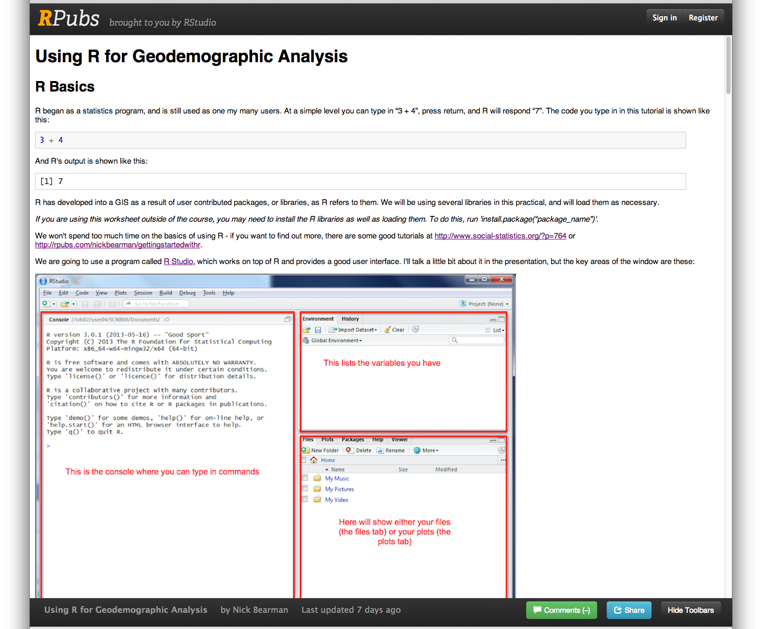
Practical

Slide 44
Survey Questions
Part of my research is GIS teaching
Very quick (7 ques) survey of your GIS experience
Follow up in 6 months / 1 year
Optional

Slide 45

Installing R Studio 0.98…

Slide 46
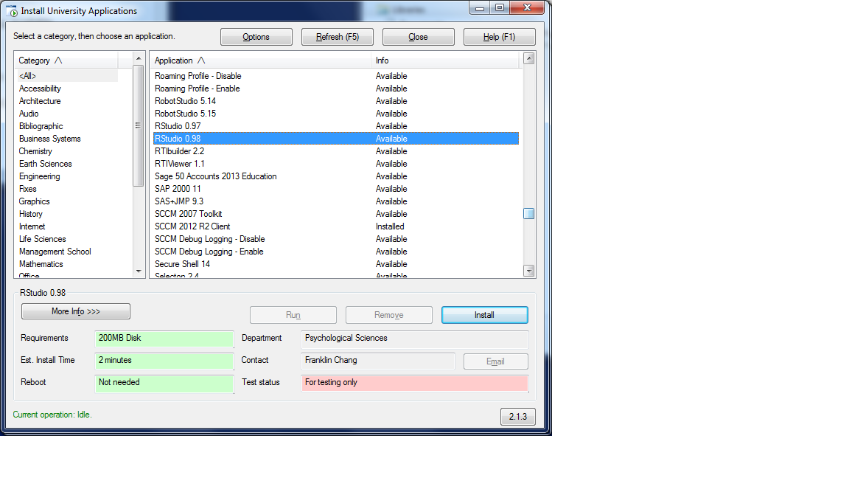
Installing R Studio 0.98…
bit.ly/1jpapm7

Slide 47
Survey:
bit.ly/1jpapm7
Practical:
bit.ly/1pZ8G9H

Slide 48
Go!

Slide 49
Practical:
bit.ly/1pZ8G9H
Libraries:
library(maptools)
Extra:
http://rpubs.com/nickbearman/geodemographics

Slide 50
Recap
Recap of the practical
Geodemographics – the future
Where now?
Feedback

Slide 51
The Practical
Using R & R Studio
Creating R scripts (& saving them!)
Importing data (OAC, OAs)
Joining Data
Making Maps
Available online
Tuesday on Google Maps

Slide 52
Geodemographics – The Future
Continually developing area
Big data and public participation a big future contribution
Current work from Geographic Data Science Lab

Slide 53
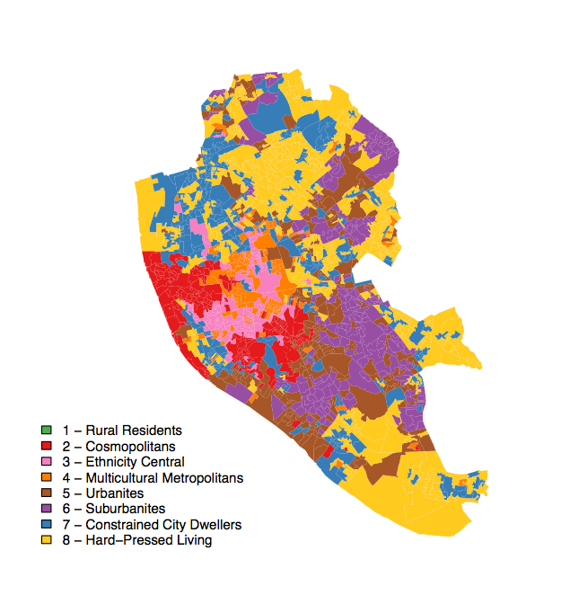
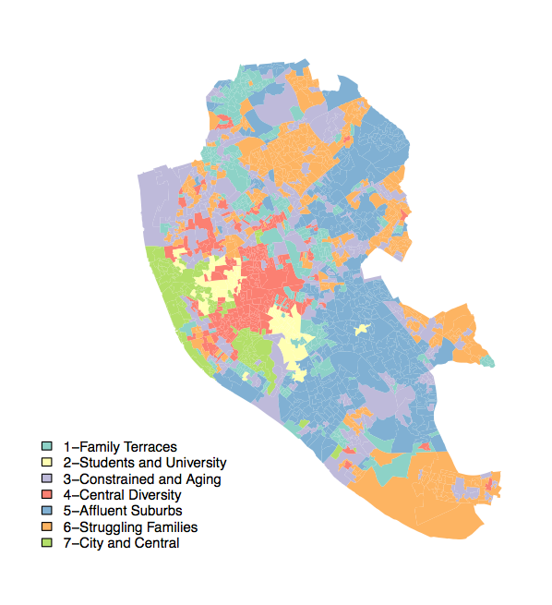
Local Classification
a classification for Liverpool versus OAC 2011 (right)
Notes:
Geographically weighting – how do you account for local differences – this is OAC 2011 (right) versus a classification for Liverpool which was created with the same data and methods, with the only difference being the area extent.

Slide 54
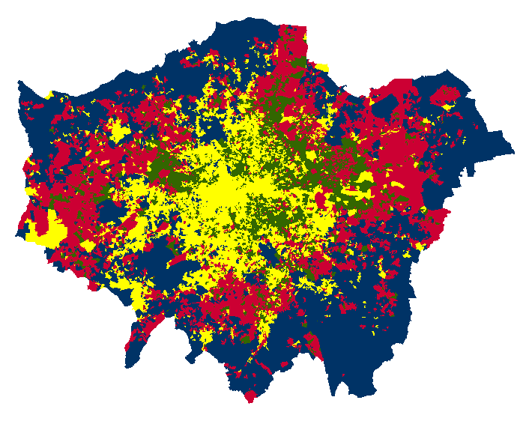
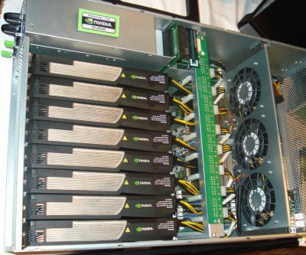
K-means (100 runs of k-means on OAC data set for k=4)
One size fits all?
Big data and real time geodemographics – how can you optimize classifications quickly and from large temporally dynamic data sources
Singleton, A., Longley, P.A. (2009) Creating Open Source Geodemographics: Refining a National Classification of Census Output Areas for Applications in Higher Education. Papers in Regional Science, 88(3), 643-666.
Adnan, M., Longley, P.A., Singleton, A.D., Brunsdon, C. (2010) Towards Real-Time Geodemographics: Clustering Algorithm Performance for Large Multidimensional Spatial Databases. Transactions in GIS, 14(3),283 – 297 .
Notes:
Big data and real time geodemographics – how can you optimize classifications quickly and from large temporally dynamic data sources

Slide 55
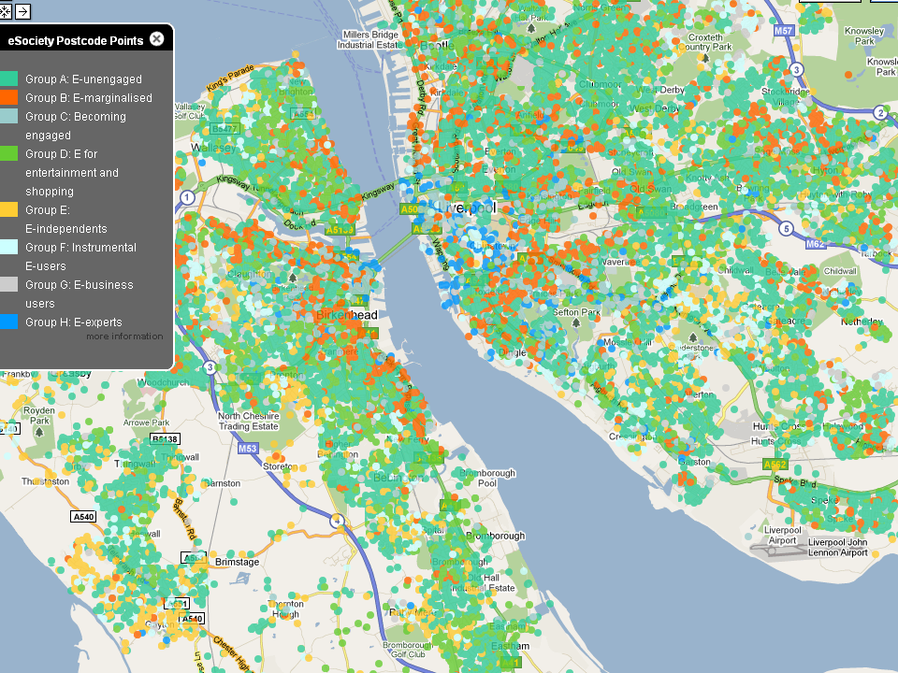
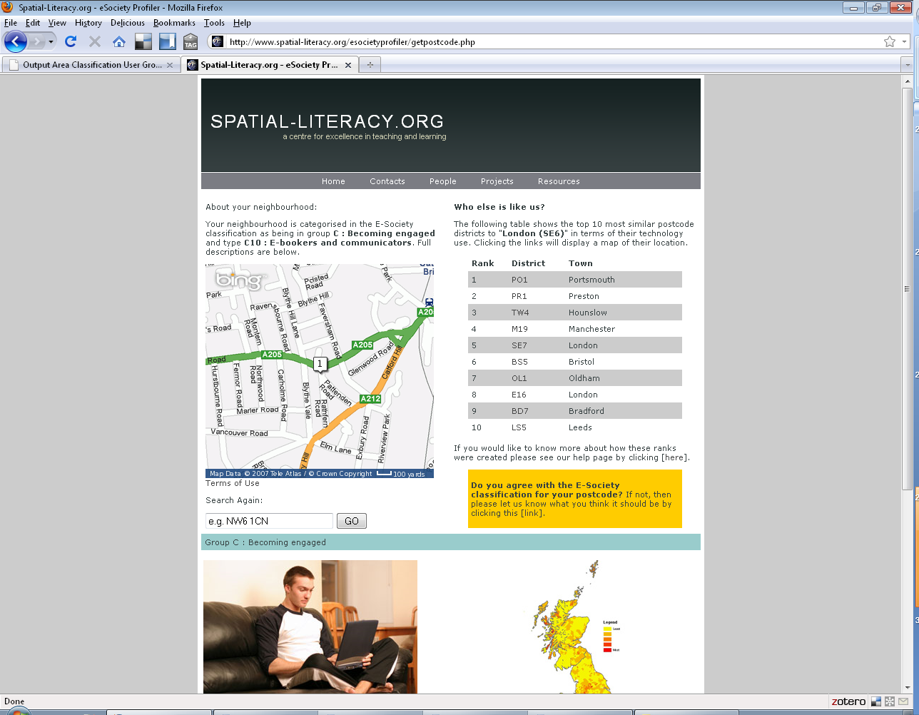
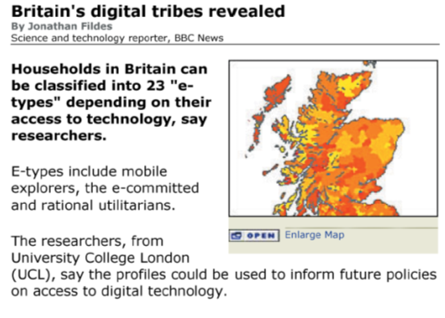
How can greater social responsibility be incorporated into geodemographics – public feedback mechanisms
79,051 hits over the 13 day period
3,952 feedback responses
Longley, P., Singleton, A.D. (2009) Classification through Consultation: Public Views of the Geography of the e-Society. International Journal of Geographical Information Science, 23(6), 737 – 763.
Notes:
How can greater social responsibility be incorporated into geodemographics – public feedback mechanisms

Slide 56
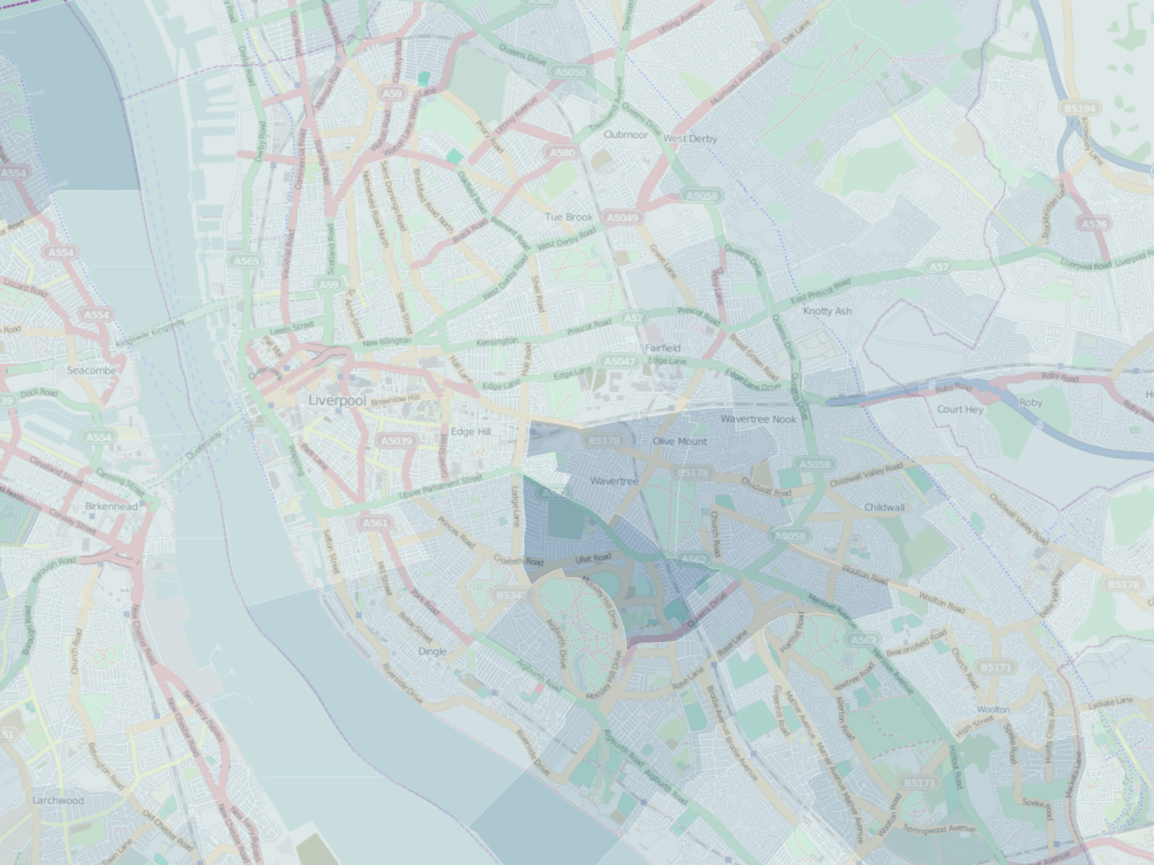
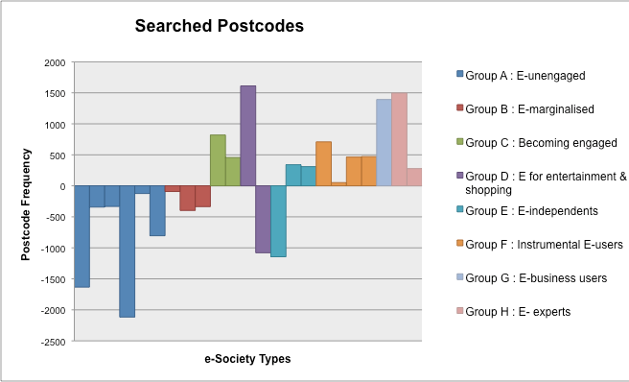
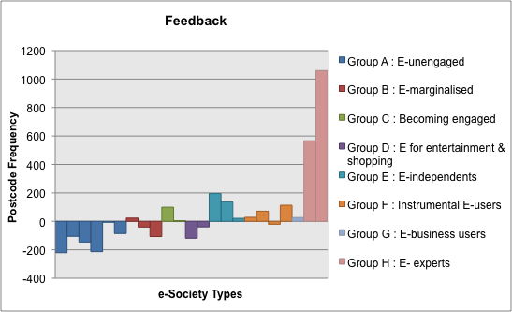
Longley, P., Singleton, A.D. (2009) Classification through Consultation: Public Views of the Geography of the e-Society. International Journal of Geographical Information Science, 23(6), 737 – 763.

Slide 57
Geodemographics – The Future
Much to be done – watch this space!

Slide 58
Where now?
R resources on the web
www.rpubs.com/nickbearman
www.youtube.com/user/marinstatlectures/playlists
http://cran.r-project.org/doc/contrib/intro-spatial-rl.pdf
R problems
www.alex-singleton.com/R-Tutorial-Materials/
“Why doesn’t my code work? - Common things to check”

Slide 59
Feedback
Feedback is really important for me
Post-its
One thing you found fun
One thing you found challenging and useful
One thing you would improve
Or email / phone / in person

Slide 60
Thank you!

